Slide 1
Day 8: Classification
TASKS
1) Predicting Height from Gender (and other variables)
2) Calculating probabilities
3) Classification with Linear Regression
4) Classification with Logistic Regression
5) Classification with Linear Discriminant Analysis
(and Quadratic Discriminant Analysis)
ISSU2028 Data Science Dr Phil Lewis

Slide 2
Day 8: Classification
Skills:
Be able to perform classification using logistic regression in R and interpret the results.
Be able to perform a LDA and QDA in R and interpret the results.
ISSU2028 Data Science Dr Phil Lewis

Slide 3
Day 8: Classification
Objectives:
Understand how to calculate probabilities using R from a dataset.
Understand how we can use a regression to perform a classification.
Understand the form of the logistic regression fit and why it is used.
Understand the concepts and assumptions of LDA and how it compares to the logistic regression.
ISSU2028 Data Science Dr Phil Lewis

Slide 4
Day 8: Classification
Resources:
Introduction to Statistical Learning Chapter 4
(see slides and videos)
Chapter 4: Classification (slides, playlist)
Introduction to Classification (10:25)
Logistic Regression and Maximum Likelihood (9:07)
Multivariate Logistic Regression and Confounding (9:53)
Case-Control Sampling and Multiclass Logistic Regression (7:28)
Linear Discriminant Analysis and Bayes Theorem (7:12)
Univariate Linear Discriminant Analysis (7:37)
Multivariate Linear Discriminant Analysis and ROC Curves (17:42)
Quadratic Discriminant Analysis and Naive Bayes (10:07)
Lab: Logistic Regression (10:14)
Lab: Linear Discriminant Analysis (8:22)
Lab: K-Nearest Neighbors (5:01)
ISSU2028 Data Science Dr Phil Lewis

Slide 5
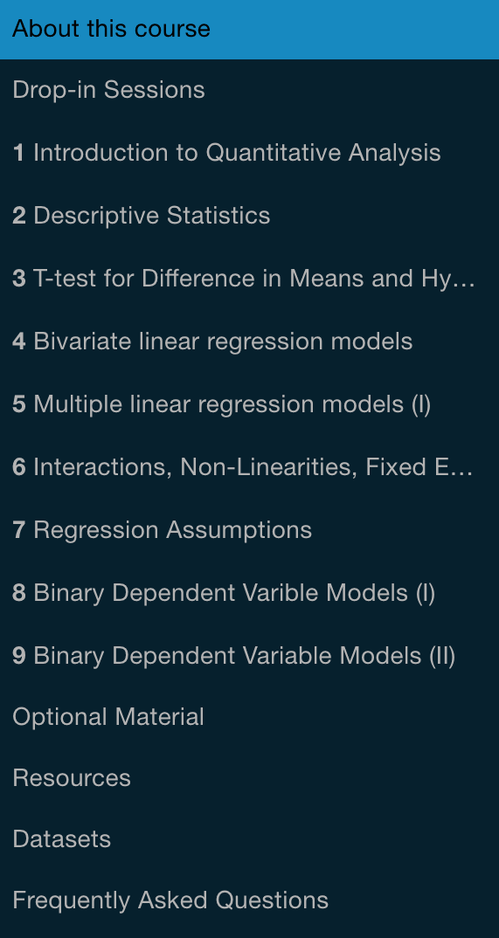
Day 8: Classification
Resources:
UCLSPP Slides and Seminars
Advanced Quantitative Methods:
Covers classification logistic regression / LDA / QDA
https://uclspp.github.io/PUBLG088/seminar3.html
Introduction to Quantitative Methods
Develops idea of Logistic Regression in more detail
http://uclspp.github.io/PUBLG100/seminar8.html
http://uclspp.github.io/PUBLG100/seminar9.html
ISSU2028 Data Science Dr Phil Lewis

